Slide 1
Cascadia Connections Exercise

Slide 2
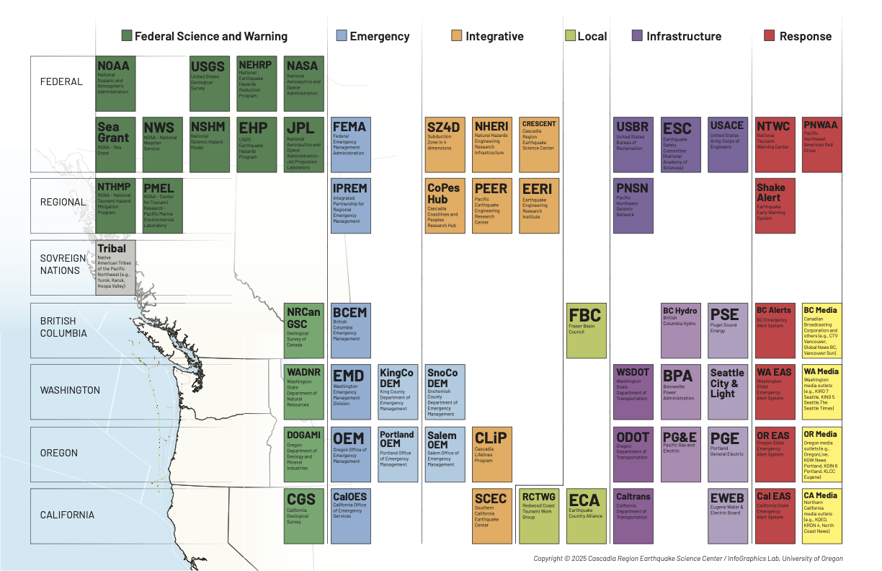
Goals:
The "science to resilience" space in the PNW is diverse and interconnected
Network: Learn about our connections to each other and our work
Contextualize CRESCENT Science: Help us understand how to best fit into the existing web of relationships to benefit your work
Notes:
Describe the table and the organizations/type of organizations

Slide 3
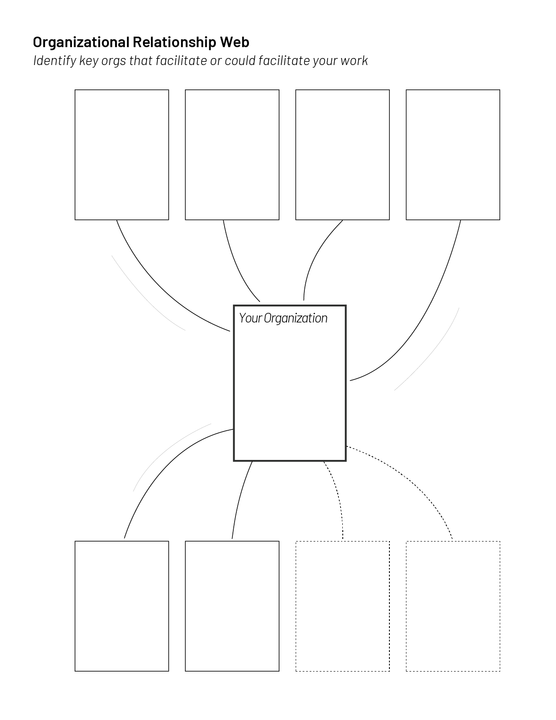
Instructions:
Part 1 – On Your Own, on this slide:
Fill in your “nodes” – you, and the organizations you interact with
Add/delete arrows indicating a relationship between you/your organization, and your neighboring nodes:
The type of relationship (provide data, listen/learn about needs, provide modeling, receive funding, etc.)
An arrow indicating flow of information
Org 1
Org 2
Example:
When you are done, please email this back to us
Type of relationship/flow of information
Your Org
Org Type
Notes:
Identify place on network map (2 minutes to individual think)
**CHIME
Give individual intros at tables (7 minutes, quick around the table)
Discussion on current pathways/ relationships to nodes and suggestions for edits and additions. (30 minute discussion)
**CHIME
Discussion on your ideal relationships to nodes (5 minute discussion)
**CHIME
Brief share out ask for 4-5 volunteers - how they might use (10 minutes)

Slide 4
Instructions:
Part 2 – As a group:
Introduce yourselves to your group using the web
If you are not on the periodic table, have Kellum add youand your organization/type on your group’s periodic table
Discuss your webs amongst your group, and what the nature of your relationships are
Notes:
Identify place on network map (2 minutes to individual think)
**CHIME
Give individual intros at tables (7 minutes, quick around the table)
Discussion on current pathways/ relationships to nodes and suggestions for edits and additions. (30 minute discussion)
**CHIME
Discussion on your ideal relationships to nodes (5 minute discussion)
**CHIME
Brief share out ask for 4-5 volunteers - how they might use (10 minutes)

Slide 5
Instructions:
Part 3 – On this slide:
With this web, draw how your ideal web would look to improve resilience and connections in the region
Assign someone to share out 1 main take home point
Org 1
Org 2
Example:
When you are done, please email this back to us
Type of relationship/flow of information
Your Org
Org Type
Notes:
Identify place on network map (2 minutes to individual think)
**CHIME
Give individual intros at tables (7 minutes, quick around the table)
Discussion on current pathways/ relationships to nodes and suggestions for edits and additions. (30 minute discussion)
**CHIME
Discussion on your ideal relationships to nodes (5 minute discussion)
**CHIME
Brief share out ask for 4-5 volunteers - how they might use (10 minutes)

